Slide 1

SSG MCS DMP Knowledge Sharing Session
December2011
Navin Pai – GE Energy
Sunil Mandhan – GE Energy

Slide 2
Agenda
DMP & Kaizen – Value to Business
Agile Retrospective – Process
DMP & Kaizen in Retrospective
Pilot Implementation
SSG MCS DMP Portal
QA

Slide 3
DMP & Kaizen – Value to Business
DMP – Health of the System
DMP – Cost Saving Opportunities
DMP – Productivity Improvements – Less turn around time.
Kaizen - Small but effective improvements
Kaizen – Large number of small improvements are better than one single big improvement

Slide 4

Agile Retrospective – Process
Team sits together.
What went well.
What improvements needed.
Discuss impediments.
Formal Idea Generation

Slide 5
DMP & Kaizen in Retrospective
Sprint Retrospective – Great Opportunity
Brainstormed Impediments
Productive ideas implemented in last sprint
Project Vision – productivity and cost saving ideas
Important stage – when ideas are fresh in the team
Team motivation and strength

Slide 6
DMP & Kaizen in Retrospective
Process – how it goes
Separate bucket for DMP & Kaizen
Team brainstorm for 5 to 10 minutes.
Look for any opportunity in the impediments.
Look for any opportunity by the motivation of finding one.
Thought of re-using idea from other teams – reusing source code/processes
Coming up 2-3 DMP projects every month.

Slide 7
Pilot Implementation – Bently Balance
Separate bucket for Kaizen & DMP
3 Ideas captured in a single retrospective
Needs to be driven from the Top Management.

Slide 8
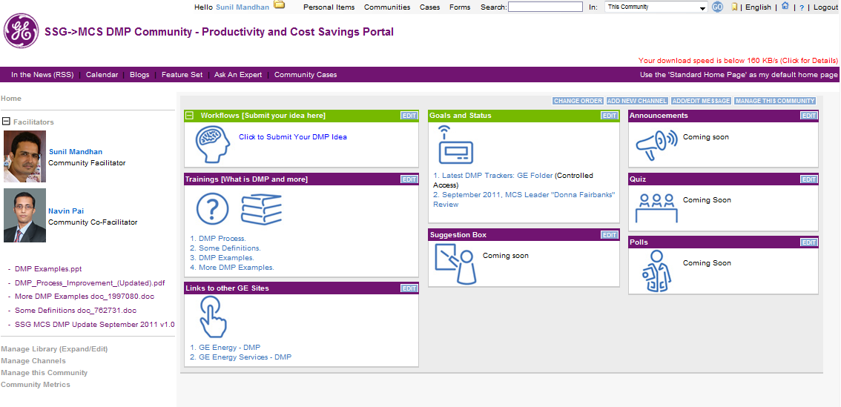
SSG MCS DMP Portal – Initiative http://supportcentral.ge.com/products/sup_products.asp?prod_id=185990
Screen shot of site and
Link to it.

Slide 9

Q&A
Thank you all

